Slide 1
Book 1 Unit 5 Nelson Mandela
Reading ：Elias’ Story

Slide 2
ONE
Warming-up
TWO
FOUR
CONTENTS
Reading
Fast reading
Improvement
THREE
Careful reading

Slide 3
Part one Warming up

Slide 4
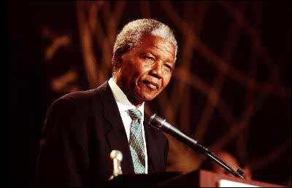
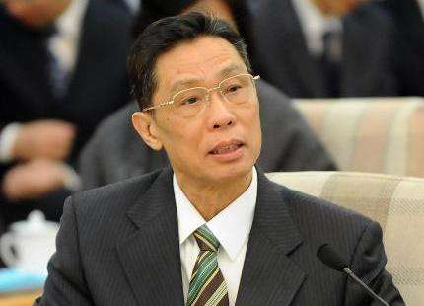
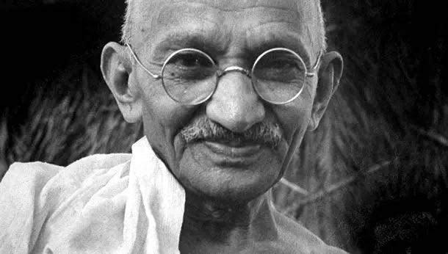
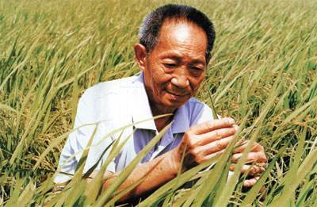
selfless
hard-working
devoted
determined
brave

Slide 5
Part two Fast reading
Read the passage as quickly as you can, and finish following tasks.

Slide 6
Fast reading( skimming)
Who is Elias?
What’s the relationship between Elias and
Mandela?
B
The passage is developed in order of ( )
A. space B. time
The reading text is a/an ___________
Narration
Argumentation
B

Slide 7
Part three: Careful reading

Slide 8
Careful reading– Pair work
Why did Elias visit Nelson Mandela?
What did Mandela do to help black people?
What was Elias’ s attitude towards the unfair situation black people faced？
Why did Mandela turn to violence to make black and white people equal?
Because he needed Mandela’s help.
Mandela helped black people by offering guidance to them on legal problems
He felt angry about the unfair situation.
Because the peaceful way was not allowed

Slide 9
Make a summary
Elias
Mandela
G
12 years old
why
Age: ____________
Race: ____________
Occupation: _____________
Education:_____________
Problem:_______________
black
black
Race: _______________
Occupation:__________
Qualities:____________
miner
lawyer
very little education
generous kind
warm-hearted
There was a time.....I worried…….
How
follower supporter
Elias’ life
gGG
helper life saver

Slide 10
Part four: Improvement

Slide 11
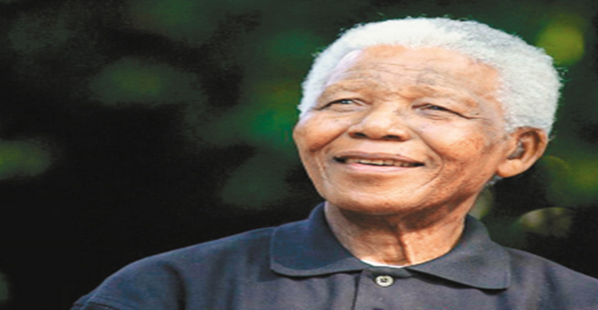
Discussion: Use some adjectives to describe Mandela.
….
generous
reliable
G
determined
wise
selfless
brave

Slide 12
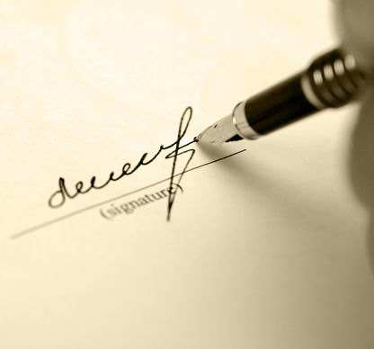
Writing
Write a brief introduction for Mandela
Tips:
1.qualities(generous/
selfless/honest//selfish/
determined/wise/brave))
2.Topic sentence; 3.supporting facts;
4. His influence
① Basic information about Mandela .
②.Give an example to show the quality.
③.What influence did Mandela bring?

Slide 13
Thank for your listening!

Slide 14
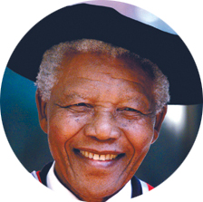
Nelson Mandela—a modern hero
Let there be justice for all.
Let there be peace for all.
Let there be work, bread, water and salt for all.
----- Nelson Mandela
钟声响起归家的讯号 在他生命里仿佛带点唏嘘黑色剪给他的意义 是一生奉献肤色斗争
中年月把拥有变做失去 疲倦的双眼带着期望 今天只有残留的驱壳 迎接光辉岁月 风雨中抱紧自由 一生经过傍徨的挣扎 自信可改变未来 问谁又能做到

Slide 15
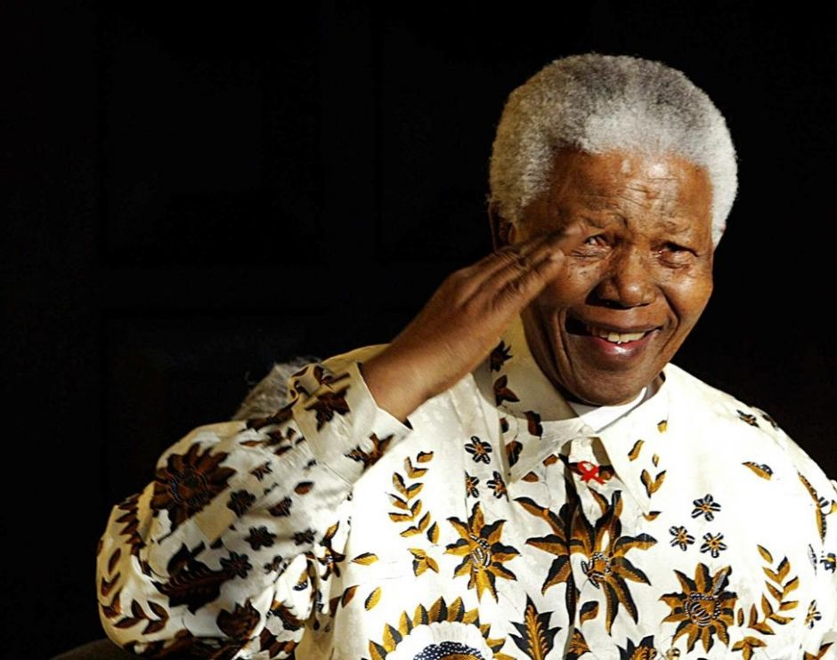
Make up a Dialogue ----Group discussion
Design some good questions according to the passage.
interviewer
Mandela said:……

